Slide 1
DESIGN AND ANALYSIS OF ALGORITHMS
Best, Average, and Worst Case
Analysis of Binary Search
A case-wise efficiency study using asymptotic notation, with a working
Python implementation and complexity comparison.
Presented by Bandi Mohith Manoj
SIMATS Engineering | CSA0619 - DAA

Slide 2
01 INTRODUCTION
Why study Binary Search?
Searching is one of the most frequently executed operations in computing — from database lookups to compiler symbol tables.
PREREQUISITE
1
Array must be
SORTED
2
Binary Search is the canonical divide-and-conquer search algorithm: it repeatedly halves the search space instead of scanning it linearly.
CORE IDEA
Compare target with the middle element, then discard
half the array each step.
3
Because its running time changes sharply with where the target lies, it is an ideal case study for best, average, and worst-case analysis.
SEARCH SPACE SHRINKS AS
n → n/2 → n/4 → ... → 1
02

Slide 3
02 PROBLEM STATEMENT
Defining the search problem
Given: A sorted array A[0..n−1] of n comparable elements, and a search key K. Find: The index i such that A[i] = K, or report that K is not present in A.
INPUT CONDITIONS
1
2
3
4
Ordering
Access
Size (n)
Key position
Array must be sorted in ascending (or descending) order.
Random access to any index in O(1) — arrays, not linked lists.
Number of elements; determines the recursion / loop depth.
Where K sits relative to the midpoints visited — drives which case occurs.
03

Slide 4
03 ALGORITHM
Algorithm and Pseudocode
ALGORITHM STEPS
BINARY_SEARCH(A, n, K)
low ← 0
high ← n - 1
while low ≤ high do
mid ← (low + high) / 2
if A[mid] = K then
return mid // found
else if A[mid] < K then
low ← mid + 1 // go right
else
high ← mid - 1 // go left
end if
end while
return -1 // not found
PSEUDOCODE
1
Set low = 0 and high = n − 1.
2
While low ≤ high, compute mid = ⌊(low + high) / 2⌋.
3
If A[mid] = K → return mid (found).
4
If A[mid] < K → search right half: low = mid + 1.
5
Else → search left half: high = mid − 1.
6
If low > high, K is not present → return −1.
04

Slide 5
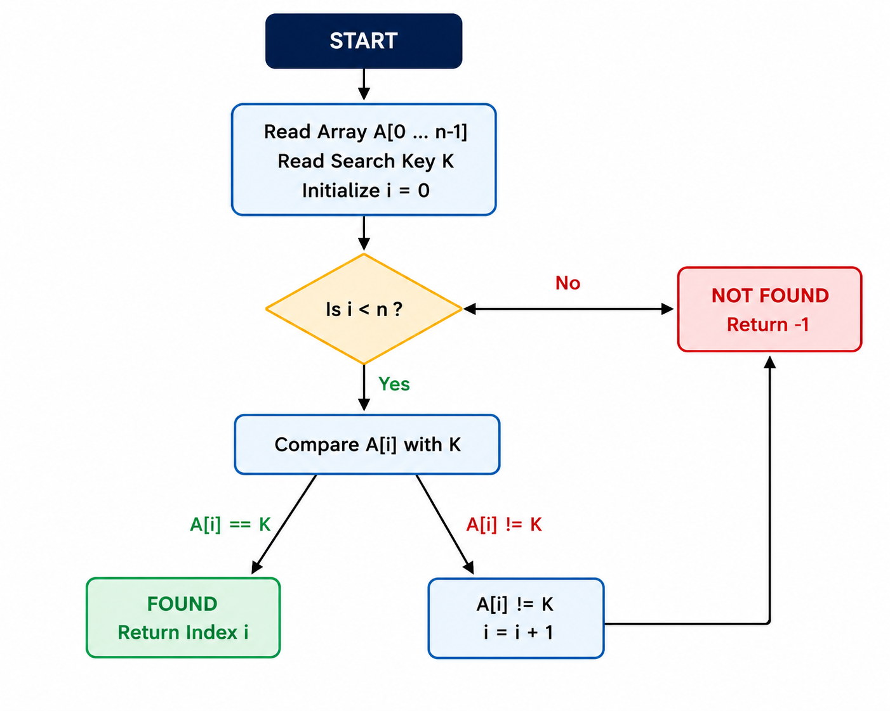
04 ARCHITECTURE
Working: Control Flow Diagram
05

Slide 6
05 IMPLEMENTATION
Python Implementation
def binary_search(arr, target):
low, high = 0, len(arr) - 1
comparisons = 0
while low <= high:
comparisons += 1
mid = (low + high) // 2
if arr[mid] == target:
return mid, comparisons # BEST case: found at mid
elif arr[mid] < target:
low = mid + 1 # search right half
else:
high = mid - 1 # search left half
return -1, comparisons # WORST case: not found
# Precondition: arr must already be sorted
arr = [3, 8, 12, 19, 23, 29, 34, 41, 47, 53, 58, 64, 71, 78, 85]
index, steps = binary_search(arr, 23)
print(f"Found at index {index} using {steps} comparisons")
binary_search.py
06

Slide 7
06 OUTPUT
Program Output — Demonstration
Sorted array of n = 15 elements. Three runs demonstrate the best, average, and worst-case behavior of the same program.
Terminal Output
Sorted Array: [3, 8, 12, 19, 23, 29, 34, 41, 47, 53, 58, 64, 71, 78, 85]
Array Size (n): 15
Case 1: BEST CASE (target = mid element on first check)
Step 1: low=0, high=14, mid=7, arr[mid]=41
Target 41 found at index 7 in 1 comparison(s)
Case 2: AVERAGE CASE (target = 23, a few levels deep)
Step 1: low=0, high=14, mid=7 Step 3: low=4, high=6, mid=5
Step 2: low=0, high=6, mid=3 Step 4: low=4, high=4, mid=4
Target 23 found at index 4 in 4 comparison(s)
Case 3: WORST CASE (target = 99, not present)
Step 1: mid=7 Step 2: mid=11 Step 3: mid=13 Step 4: mid=14
Target 99 not found -> result -1 in 4 comparison(s)
07

Slide 8
07 COMPLEXITY ANALYSIS
Best, Average, and Worst Case
Case | Condition | Comparisons | Notation
Best | Target is the middle element | 1 | Ω(1)
Average | Target anywhere else in the array | ≈ log₂(n) | Θ(log n)
Worst | Target absent, or the last element checked | ⌊log₂ n⌋ + 1 | O(log n)
COMPARISONS vs. ARRAY SIZE (n)
Space complexity: O(1) iterative · O(log n) recursive (call stack)
Compare with Linear Search: Best O(1), Average O(n), Worst O(n).
Binary Search's log n growth is why it scales to large, sorted datasets far better than a linear scan.
08

Slide 9
08 CONCLUSION
Which case matters most?
In real-world systems, the average case is usually the most significant. Search queries rarely land exactly on the midpoint (best case, rare in practice), and a well-formed sorted dataset rarely forces every step to the last comparison (pure worst case). Systems are designed and benchmarked around expected, everyday load — which the Θ(log n) average case captures.
AT A GLANCE
Ω(1)
Best case
Θ(log n)
That said, the worst case remains critical for safety-critical and real-time systems (e.g. embedded, financial trading), where a guaranteed upper bound O(log n) is what makes binary search dependable at scale — far outperforming linear search's O(n) as n grows.
Average case
O(log n)
Worst case
REFERENCES
Thank you
1. Cormen, Leiserson, Rivest, Stein — Introduction to Algorithms (CLRS), 3rd Ed., MIT Press.
2. Sartaj Sahni — Data Structures, Algorithms, and Applications in C++.
3. Ellis Horowitz et al. — Fundamentals of Computer Algorithms.
4. GeeksforGeeks — Binary Search Algorithm, geeksforgeeks.org.
09

